Slide 1


Our team !!!
Christos Patitis
Kateryna Ocheretenko
HIGHER EDUCATION IN CULINARY ART
BIOLOGIST

Slide 2
Understanding the Environmental Impacts of Food Production: A Data-Driven Analysis
By Christos Patitis and Kateryna Ocheretenko

Slide 3
01
02
Study Overview
03
04
Objective
Research & data collection
Data Analysis
Results
05
Recommendation/Conclusions

Slide 4
01
Identifying the problem

Slide 5
www.mdpi.com/2260102
"Global warming has become one of the major threats to the security of human survival. Agricultural production has been widely suspected as one of the main sources of anthropogenic carbon emissions. Analyzing the changing characteristics and influencing factors of agricultural carbon emissions is of great significance for the mitigation of global climate change and the sustainable development in agriculture."

Slide 6
Comprehensive Carbon Impact: Total Continental Emissions Across Historical Data
Europe:
33,2%
Asia:
50,4%
N.America:
3,4%
Africa:
4,7%
Americas: 9,7%
S.America:
6,3%
Oceania:
2,1%

Slide 7
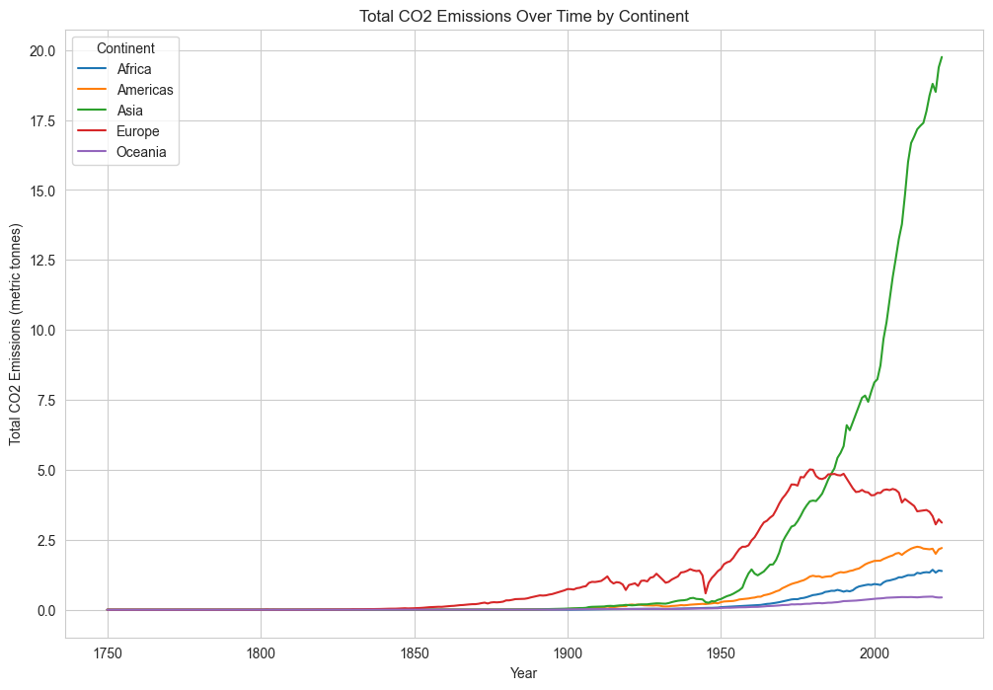
Emissions increased over time

Slide 8
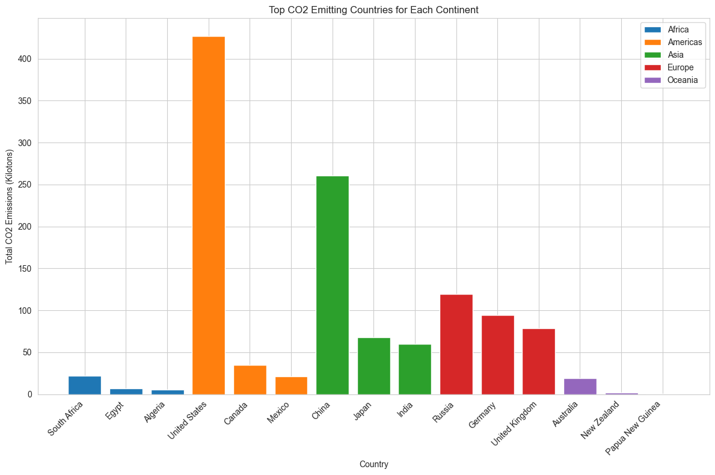
Top emission countries per continent

Slide 9
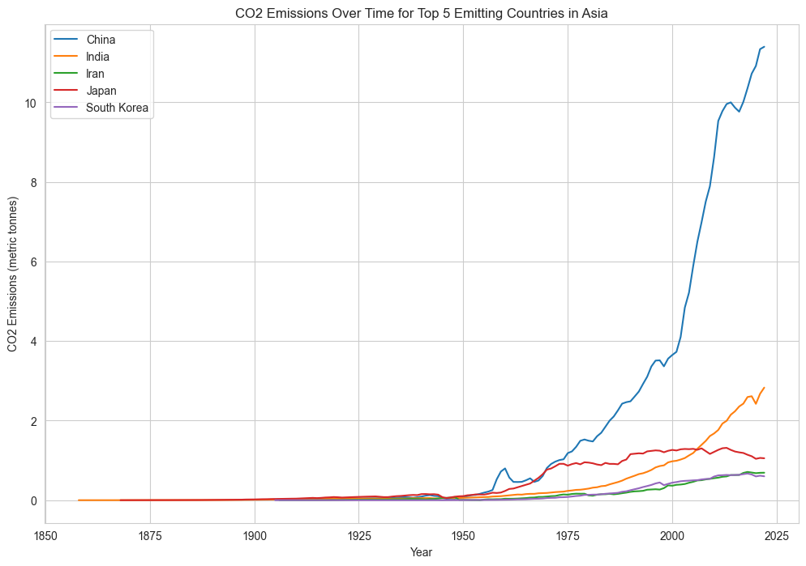
Asian country emission trend
Notes:
As a large agricultural country, China plays an important role in global food production, and its productivity growth has an important impact on global food security

Slide 10
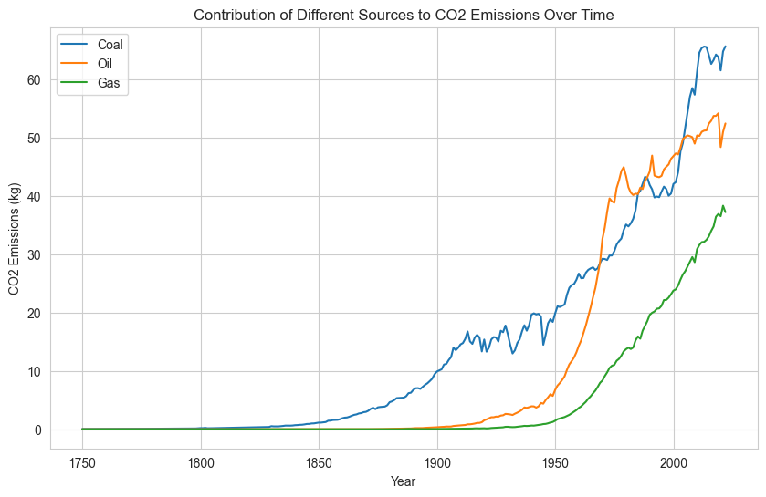
Emissions increased overtime

Slide 11
02
Agriculture exploration
Looking closer to agriculture emissions

Slide 12
www.statista.com
“ Agricultural production is estimated to account for 40 % of global food system emissions, which some experts put at roughly 18 GtCO₂e (18 billion tones)per year”

Slide 13
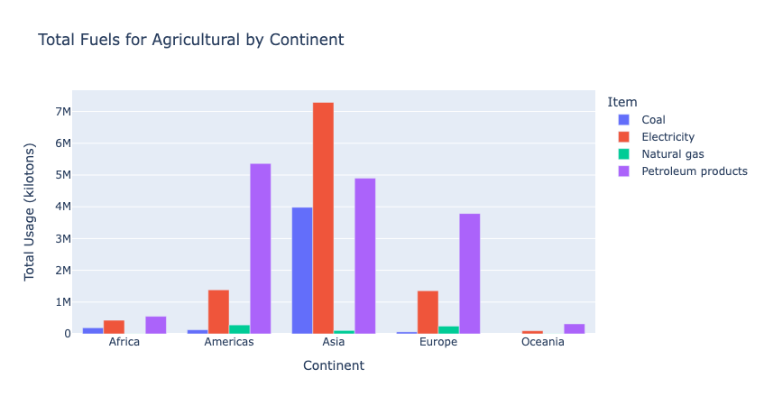
Total Agricultural Fuel Usage by Continent

Slide 14
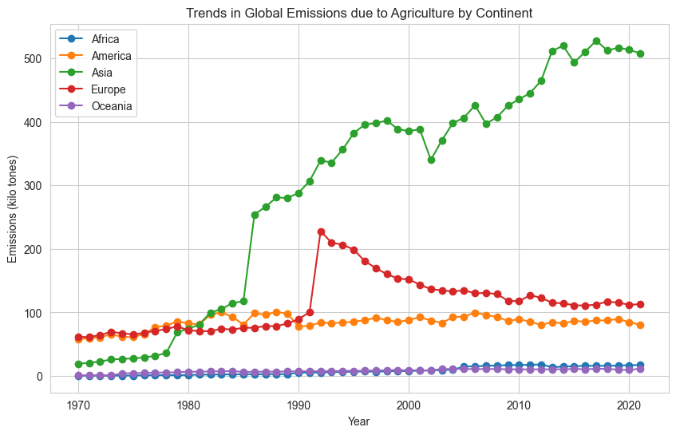
Agriculture emissions trend

Slide 15







Agriculture supply chain
Transport
Packaging
Land use
Animal Feed
Processing
Retail
Farm

Slide 16

Carbon dioxide equivalents (CO₂eq)
"Greenhouse gases are commonly measured in carbon dioxide equivalents (CO₂eq) per kilogram of food, which accounts for all greenhouse gases, not just CO₂."

Slide 17
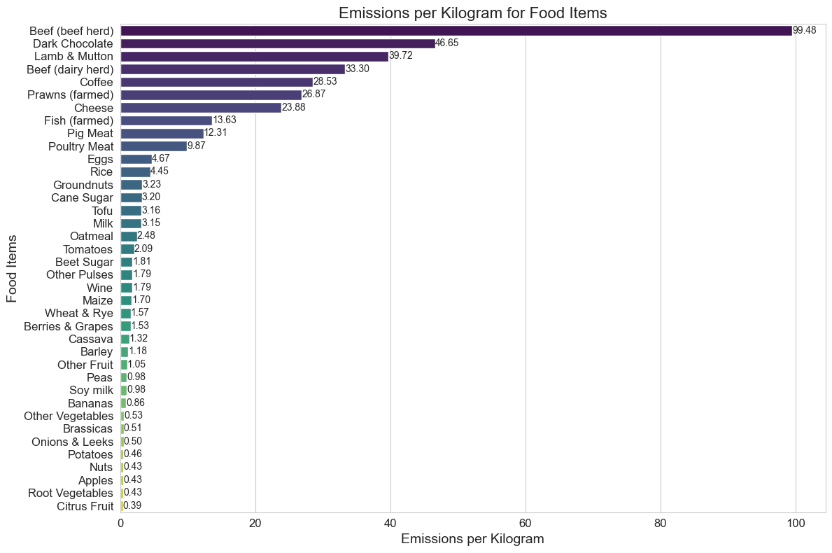
Carbon Footprint Comparison: Emissions per Kilogram of Food

Slide 18
Carbon Footprint Comparison: Emissions per Kilogram of Food

Slide 19
Carbon Footprint Comparison: Emissions per Kilogram of Food

Slide 20
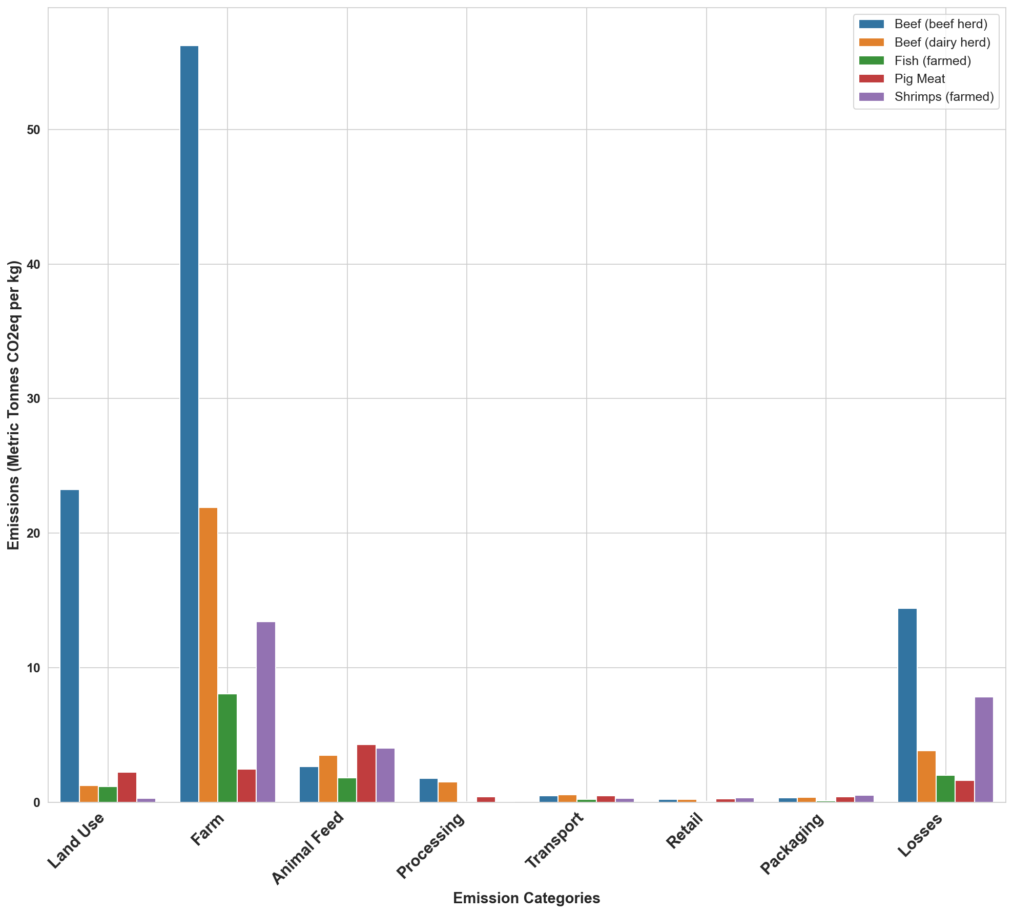
Emissions Comparison Across ‘Livestock’ Supply Chains: From Farm to Fork

Slide 21
Emissions Comparison Across ‘Livestock’ Supply Chains: From Farm to Fork

Slide 22
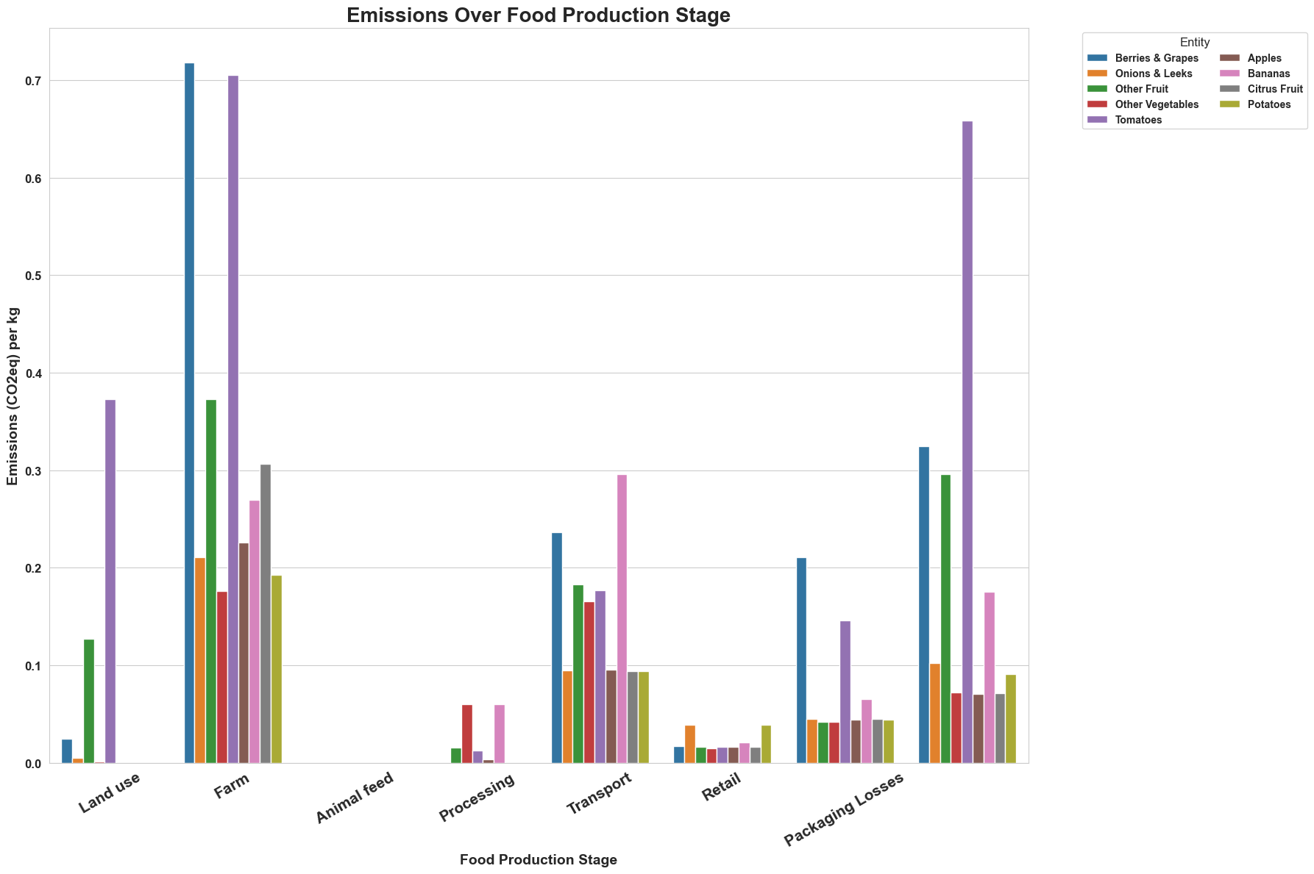


Environmental Footprint of ‘Vegetable’ Supply Chains: Emissions Analysis

Slide 23
Environmental Footprint of ‘Vegetable’ Supply Chains: Emissions Analysis

Slide 24
03
Consumption
Let us dive into consumption data

Slide 25
In depth
Agriculture has a weighty environmental impact:
70% of global freshwater withdrawals
26% of global greenhouse gas emissions
50% of the world’s habitable land
Meat and dairy productions release more greenhouse gases than plant-based foods.
What we eat - matters!
https://www.fao.org/
https://www.science.org/

Slide 26
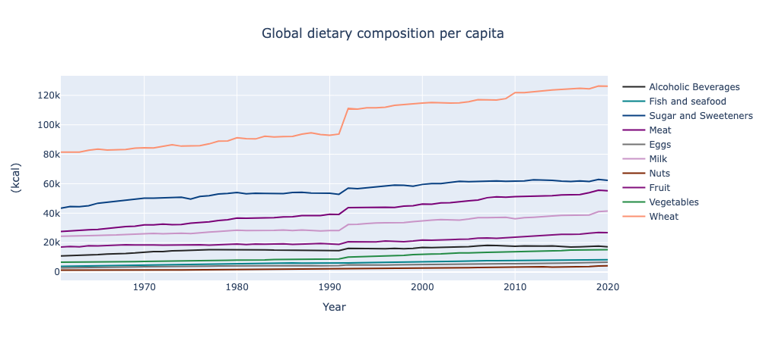
Analyzing global dietary patterns per capita: a comparative composition overview

Slide 27
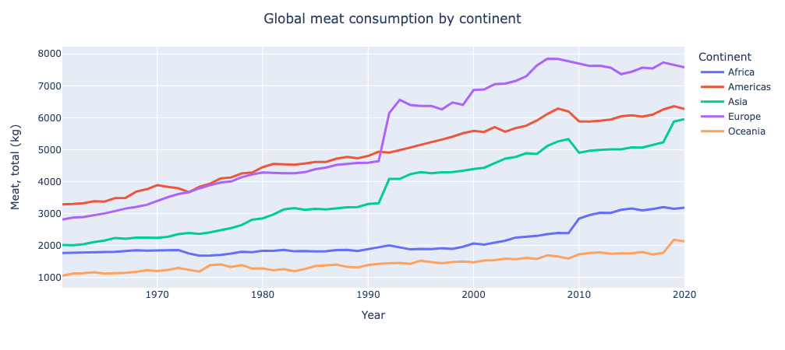
Global meat consumption trends per capita
Notes:
How Much Meat Is Consumed in the US? According to the USDA, the average US resident consumes 224.6 pounds of meat — beef, pork, broilers and turkey — every year.
https://sentientmedia.org/meat-consumption-in-the-us/#:~:text=How%20Much%20Meat%20Is%20Consumed,broilers%20and%20turkey%20%E2%80%94%20every%20year.

Slide 28
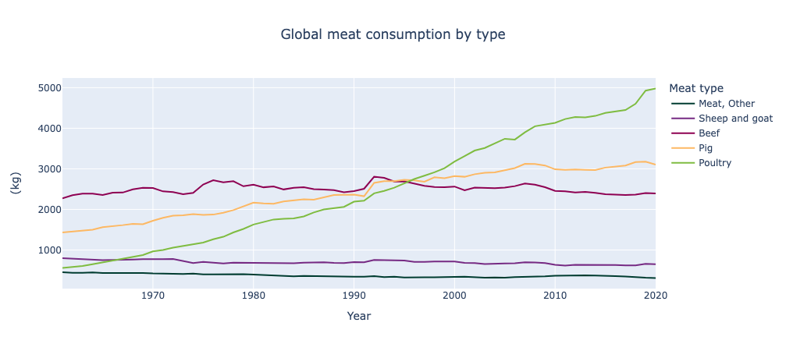
Global meat consumption by type per capita

Slide 29
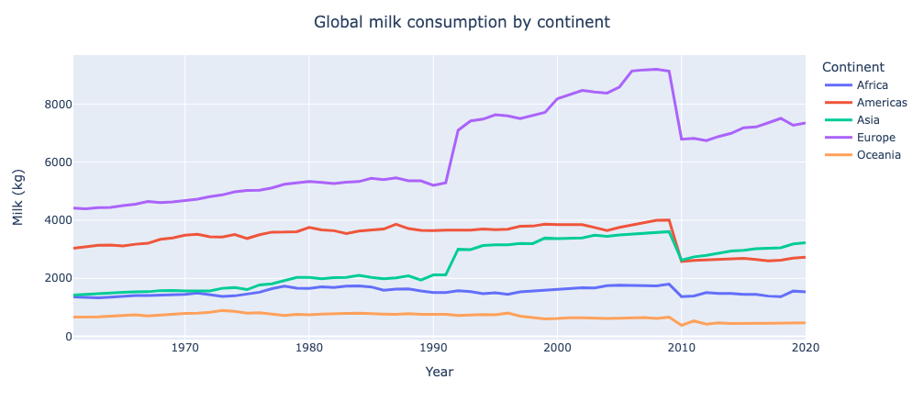
Global milk consumption per capita trends across continents
Notes:
Eggs and milk are dietary staples globally. By understanding consumption trends, we can work towards more sustainable dairy farming practices, reducing emissions along the way.

Slide 30
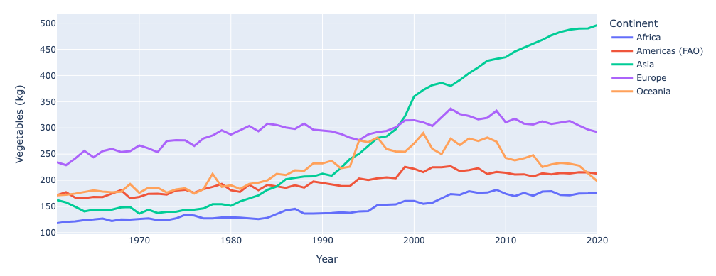
Regional vegetables consumption: A comparative analysis by continent per capita
Notes:
Vegetable consumption varies by continent, influencing emissions. Identifying these differences helps us promote plant-based diets, which are healthier and better for the environment.

Slide 31
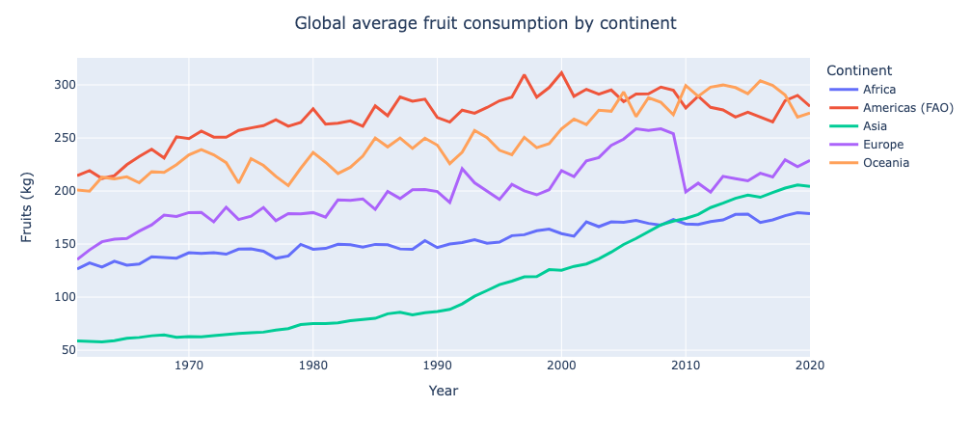
Fruit intake per capita by continent
Notes:
Lastly, let's explore global fruit consumption. Knowing how different regions enjoy fruits informs efforts to encourage healthy and eco-friendly food choices.

Slide 32
04
Conclusion
Policy Matters
Sustainable Farming is Key:
We found out that policy decisions are crucial about production and consumption
We are still attached to the old ways of production in agriculture , and far in changing to green practices
Diet Impacts Emissions:
Food choices, particularly high-emission products like beef, play a crucial role. Opting for more sustainable options can help cut down emissions.

Slide 33
05
Recommendations

Slide 34
Green Energy: Switch to more environmentally friendly agriculture infrastructures
Policy Alignment: Encourage international cooperation to align policies and regulations on carbon emissions from food production.
Promoting Sustainable Diets: Launch public awareness campaigns to educate consumers about the environmental impact of their food choices
Supporting Sustainable Farming: Provide incentives and support farmers to transition to sustainable farming practices.
Research and Innovation: Invest in research and development to advance technologies and practices that promote food production with smaller footprint.
Collaborative Action: Facilitate collaboration between governments, industry stakeholders, and civil society to develop and implement comprehensive strategies for reducing emissions from food production.

Slide 35



Thank you!
c.patitis@gmail.com
github.com/ChristosPatitis
kocheretenko@gmail.com
github.com/UAsavage

